Slide 1
“Clean Energy 2.0” . . . “ABUNDANT Clean energy or bust”

Slide 2
A Declaration of Energy… Independence ABUNDANCE

Slide 3
Create millions of NEW Jobs Spark Economic expansion achieve Energy Independence provide Food security while Saving the Planet (…for free)
How to…

Slide 4
Myths & Truths about Clean energy

Slide 5
Myths
We can’t scale new energy solutions fast enough
We can’t afford it
We don’t have enough time to save the planet
We have to do “a little bit of everything”
We have plenty of natural gas to fall back on

Slide 6
Truths
Worldwide energy use to grow by 50% within 30-40 years
The U.S. is a net importer of both natural gas AND the nitrogen fertilizer we rely upon for all of our food supply
We can achieve energy independence through clean energy and we can afford it
Nitrogen fertilizer is all made from natural gas
Doing “a little bit of everything” is a strategy for failure
We just need the right plan

Slide 7
Future Fossil Fuel Energy Consumption
Prior to Solar Breakthrough

Slide 8
Future Fossil Fuel Energy Consumption
Prior to Solar Breakthrough

Slide 9
The strategy

Slide 10
Primary resources: fuel supply
waves
World energy use
Wind
SOLAR
OTEC
Gas
BIO
Oil
HYDRO
Uranium
COAL
R. Perez et al.
Notes:
10

Slide 11
The panacea
All energy supplied by the sun
The only truly renewable solution available
No other source can provide enough energy
The only possibility for energy abundance

Slide 12
How do we win?
Solar Energy Breakthrough - Via a 5-10x breakthrough in solar energy harnessing
All other paths lead to a guaranteed fast (worst case) or slow (best case) death
Planetary survival depends on:
Stemming the tide via interim efforts
Making sure we succeed in the solar breakthrough

Slide 13
Key Principals
Choose maximum time horizon to plan for solar energy breakthrough (e.g. ~30 years / 2040)
Guarantee solar breakthrough success by:
Making it a priority / Non-optional
Increased investment
Team approach of R&D, Scalability Engineering and Business Planning talent (see “Closing the Innovation Gap”, Judy Estrin)
In the interim only invest in rapidly deployable solutions that “stem the tide” until 2040

Slide 14
technology acceleration
The Law of Accelerating Returns by Ray Kurzweil (MIT) “An analysis of the history of technology shows that technological change is exponential, contrary to the common-sense "intuitive linear" view. So we won't experience 100 years of progress in the 21st century -- it will be more like 20,000 years of progress (at today's rate).”

Slide 15
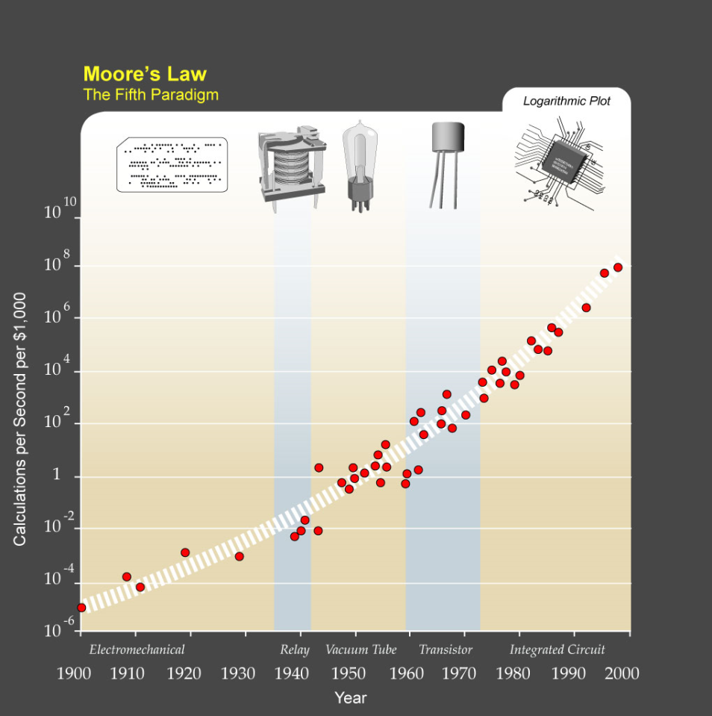
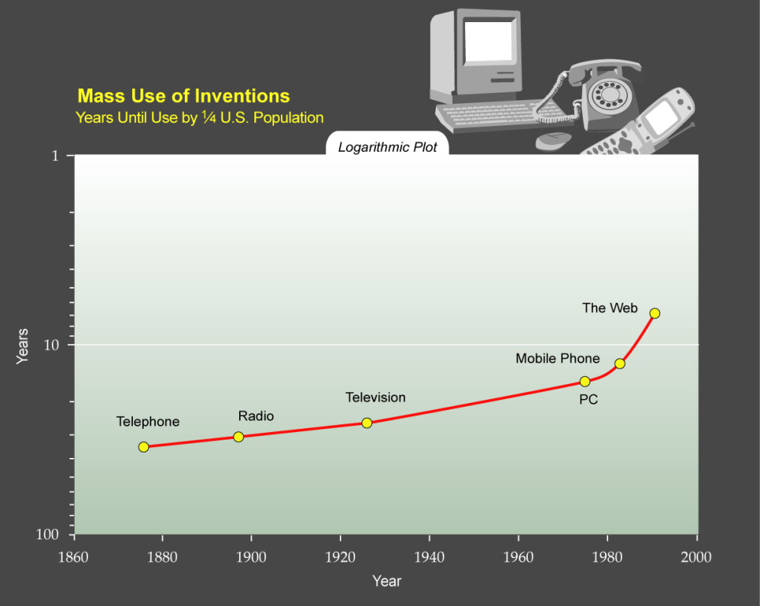
technology acceleration Graphs

Slide 16
Simplify the problem
Break the problem into “easily” digestible parts
DON’T try to do a little bit of everything
Stage the rollout as specific actions
Short Term (ST) – Immediately actionable
Medium Term (MT) – Expansion of proven technologies (or about to be proven)
Long Term – (LT) Focus R&D and Public/Private Collaboration on breakthrough opportunities

Slide 17
Staged Rollout
 | Period of ST Action Benefits
 |  |  |  |  | Period of MT Action Benefits
 |  |  |  |  |  |  |  |  |  | Period of LT Action
 |  |  |  |  |  |  |  |  |  |  | Benefits

Slide 18
Start Each Phase Now
Begin today as appropriate for each phase
ST – Efficiency Programs
MT – Investment in Commercialization Support
LT
R&D Focus
Pair with business development and engineering scalability experts

Slide 19
Strategy details

Slide 20
Stage Focus
Stage 1 – (ST) Energy Efficiency
Stage 2 – (MT) Rapidly Deployable Renewable Energy
Stage 3 – (LT) Solar Energy Breakthrough

Slide 21
Future Fossil Fuel Energy Consumption
Prior to Solar Breakthrough

Slide 22
Future Fossil Fuel Energy Consumption
Prior to Solar Breakthrough

Slide 23
Future Fossil Fuel Energy Consumption
Prior to Solar Breakthrough

Slide 24
Future Fossil Fuel Energy Consumption
Prior to Solar Breakthrough

Slide 25
Stage 1 (ST) – ENERGY Efficiency (20%)
CONSERVATION is the best opportunity
Focus on:
Guaranteed, measurable outcomes
Opportunities with quick ROI (i.e. “some not all”)
Raise awareness, begin to change behavior
Gets everyone’s “head in the game”
Begins to show some progress / stem the tide
Breeds a new culture of success
Establishes general belief that we can win

Slide 26
Stage 2 (MT) – Renewable Energy (20%)
Invest now and drive support policies for:
Energy technology deployments that begin to move the bar (>1% of energy use)
MUST be MUCH BETTER than corn ethanol
Changing the way we build communities and live so as to use less energy as a society
Focus is on:
Alternative fuels WITHOUT the “food vs. fuel” tradeoff
Wind power
Land use policies that focus on higher density and improved quality of living (New Urbanism)
Green building initiatives
Supported by exceptional public transit system investment
Accelerates the “stem the tide” phase
Reinforces that we are winning

Slide 27
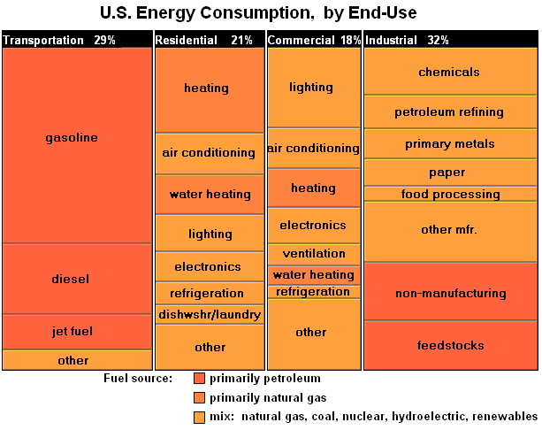
Energy Use Replacement Targets
Transportation
Gasoline >50%
Diesel ~25%
Electricity
~50% coal
Domestic Heating
Natural gas ~25%
Nitrogen Fertilizer
Natural Gas ~ 3%

Slide 28
Stage 2 – Intelligent energy replacement
Wherever possible, replace current energy uses with infrastructure compatible renewables
Transport Fuels – Focus on transition fuels that work with existing vehicles and infrastructure
Nitrogen Fertilizer – Replace with cheaper biomass
Don’t invest in new approaches that are only somewhat better. Time and cost of new infrastructure investments are too long or too high (e.g. H_{2,} Cellulosic ethanol)

Slide 29
Stage 3 (LT) – Solar Energy Breakthrough
Invest now and drive support policies for:
Solar energy technologies that have the potential to SOLVE our energy problem
MUST be able to provide an ABUNDANCE of energy
Focus is on:
SOLAR ENERGY – Truly next-generation approaches that leapfrog the current technology (e.g. multi-spectral)
ENERGY STORAGE – Provides 24 hour energy supply but less critical with energy abundance
Treat like a moon shot – All-hands-on-deck

Slide 30
Future Fossil Fuel Energy Consumption
After Solar Breakthrough

Slide 31
Future Fossil Fuel Energy Consumption
After Solar Breakthrough

Slide 32
Future Fossil Fuel Energy Consumption
After Solar Breakthrough

Slide 33
Future Fossil Fuel Energy Consumption
After Solar Breakthrough

Slide 34
Future Fossil Fuel Energy Consumption
After Solar Breakthrough

Slide 35
Future Fossil Fuel Energy Consumption
After Solar Breakthrough

Slide 36
Future Fossil Fuel Energy Consumption
After Solar Breakthrough

Slide 37
Recommendations

Slide 38
create new dept of clean energy (DCE)
DCE - Create a new government department who’s sole focus is the development and rapid deployment of CLEAN ENERGY (Stages 1 – 3)
Recruit best and brightest who have passion and vision from DOE, USDA , Academia and Industry
Rename DOE = “Department of Old Energy”

Slide 39
Investments – Infrastructure (ST MT LT)
National Direct Current Electric Grid
Grid reliability and redundancy (“Internet of Energy”)
“Smart Grid” Technology
Grid-scale Energy Storage (lower priority)
New N-Hydrogen3 Carbon-Free Liquid Fuel

Slide 40
New approach to govt funding
Adopt business-like approach
Think about lifecycle funding not just R&D
Use Best Practices from the best industrial companies worldwide

Slide 41
govt funding Details (1 of 2)
Create a new government investment fund
“Energy Independence Fund”
$25B per year
Behaves like the largest venture capital fund
Retains a never-dilutable 1% economic interest in everything it funds
Over time the fund will easily pay for itself - if not make money

Slide 42
govt funding Details (2 of 2)
Staged Investments
Fund every (even seemingly crazy) research idea (will naturally be the smallest portion of the fund)
Support research successes through the “investment valley of death” stage – THIS IS MISSING TODAY and is killing advancement of innovation
Typical needs are first pilot scale facility or initial commercial prototype
Subsidize as needed new products or fuel technologies until economies of scale kick in

Slide 43
Create Govt / Business partnership
A new public- private partnership as a government service.
Focus is melding business oversight/guidance with R&D.
Study most successful industrial businesses that already do this internally to guide basic R&D investments into large scale businesses.
Examples
3M – Post-it Notes IBM
Siemens HP
GE

Slide 44
Partnership details
Businesses “volunteer” employees with a variety of skills ranging from R&D, Scalability Engineering and Business Development
Businesses that participate get inside track on new commercialization opportunities
Participants also get a % economic interest in the upside of the projects that become commercial whether they work on them directly

Slide 45
Stage Details

Slide 46
Stage 1 – Conservation STrategy
Begin with an assessment in order of “best bang for the buck” opportunity for energy reduction with high ROI (see McKinsey study http://www.mckinsey.com/clientservice/ccsi/greenhousegas.asp)
Prioritize the “short list” and create education programs for businesses and homes to drive adoption and investment

Slide 47
Stage 1 – Conservation Programs
Nationwide Efficiency Leadership Campaign
Train all children to think differently
Think about using only what is needed, don’t be wasteful
Get kids to positively influence their parents
Get every adult American to think the same way
Make the definition of being a “Good American”a.k.a. “Patriot” is to demand efficient:
Products (and packaging)
Buildings
Services
Transportation
Educate Businesses and Homes

Slide 48
Stage 2 – Renewable energy
Wind power – Deploy windmills in lock step with grid expansion
Alternative Fuels
Drop support for any food-only fuels such as corn ethanol and soy bio-diesel
Prioritize better fuels such as butanol, dimethyl ether (DME) and bio-ammonia fertilizer
Support electric vehicles with on-board backup energy sources
New N-Hydrogen3 Fuel

Slide 49
Stage 2 – Land Use and Transit
Re-think land and community development
Reward higher density development
Encourage investment in truly effective public transit
Support community vehicle-share approaches (e.g. ZipCar)

Slide 50
Stage 3 – Solar Energy
Set a goal to achieve ENERGY INDEPENDENCE if not ABUNDANCE by 2040
Focus on the only truly renewable source of energy we have – SOLAR ENERGY
Also support advancement in energy storage technologies (e.g. batteries or super-capacitors)
With proper focus, management and funding WE WILL ACHIEVE THIS

Slide 51
How to Sell It - “The Spin”

Slide 52
Conservation
Being American = Energy Conservation
National Security
“Declaration of Energy Independence”
Efficiency and New Sources of Energy will provide a safety buffer for the USA
Cost Savings
Every American – citizen, business and government will save LOTS of money

Slide 53
Land Use / Transportation
Quality of Life
Reduces commute times
More free time
Improves family dynamics
Reduces fuel use
Less expensive living
Reduces land competition for food production

Slide 54
New Energy Technology Investment
Patriotism
“A call to arms” - “We can do this together”
Dedicate your career - Be a Hero!
Economic Opportunity
“Buy Made-In-America Fuels/Energy”
New jobs are being created
National Security
Remove dependence on foreign sources of energy
Secure our food supply

Slide 55
Recap
Three - Phased Approach
Focus on a few key opportunities
Do them well, and succeed
Market it all properly
Win

Slide 56
Create millions of Green Jobs Spark Economic expansion achieve Energy Independence provide Food security while Saving the Planet (…for free)
How to…

Slide 57
“Clean Energy 2.0” . . . “ABUNDANT Clean energy or bust”

